Slide 1
Comparative analysis: U.S. Craft Beers

Slide 2
Breweries by State
States with highest number of breweries
Colorado - 47
California - 39
Michigan - 32
Oregon - 29
States with the lowest number of breweries
West Virginia - 1
South Dakota - 1
North Dakota - 1
Washington D.C. - 1

Slide 3
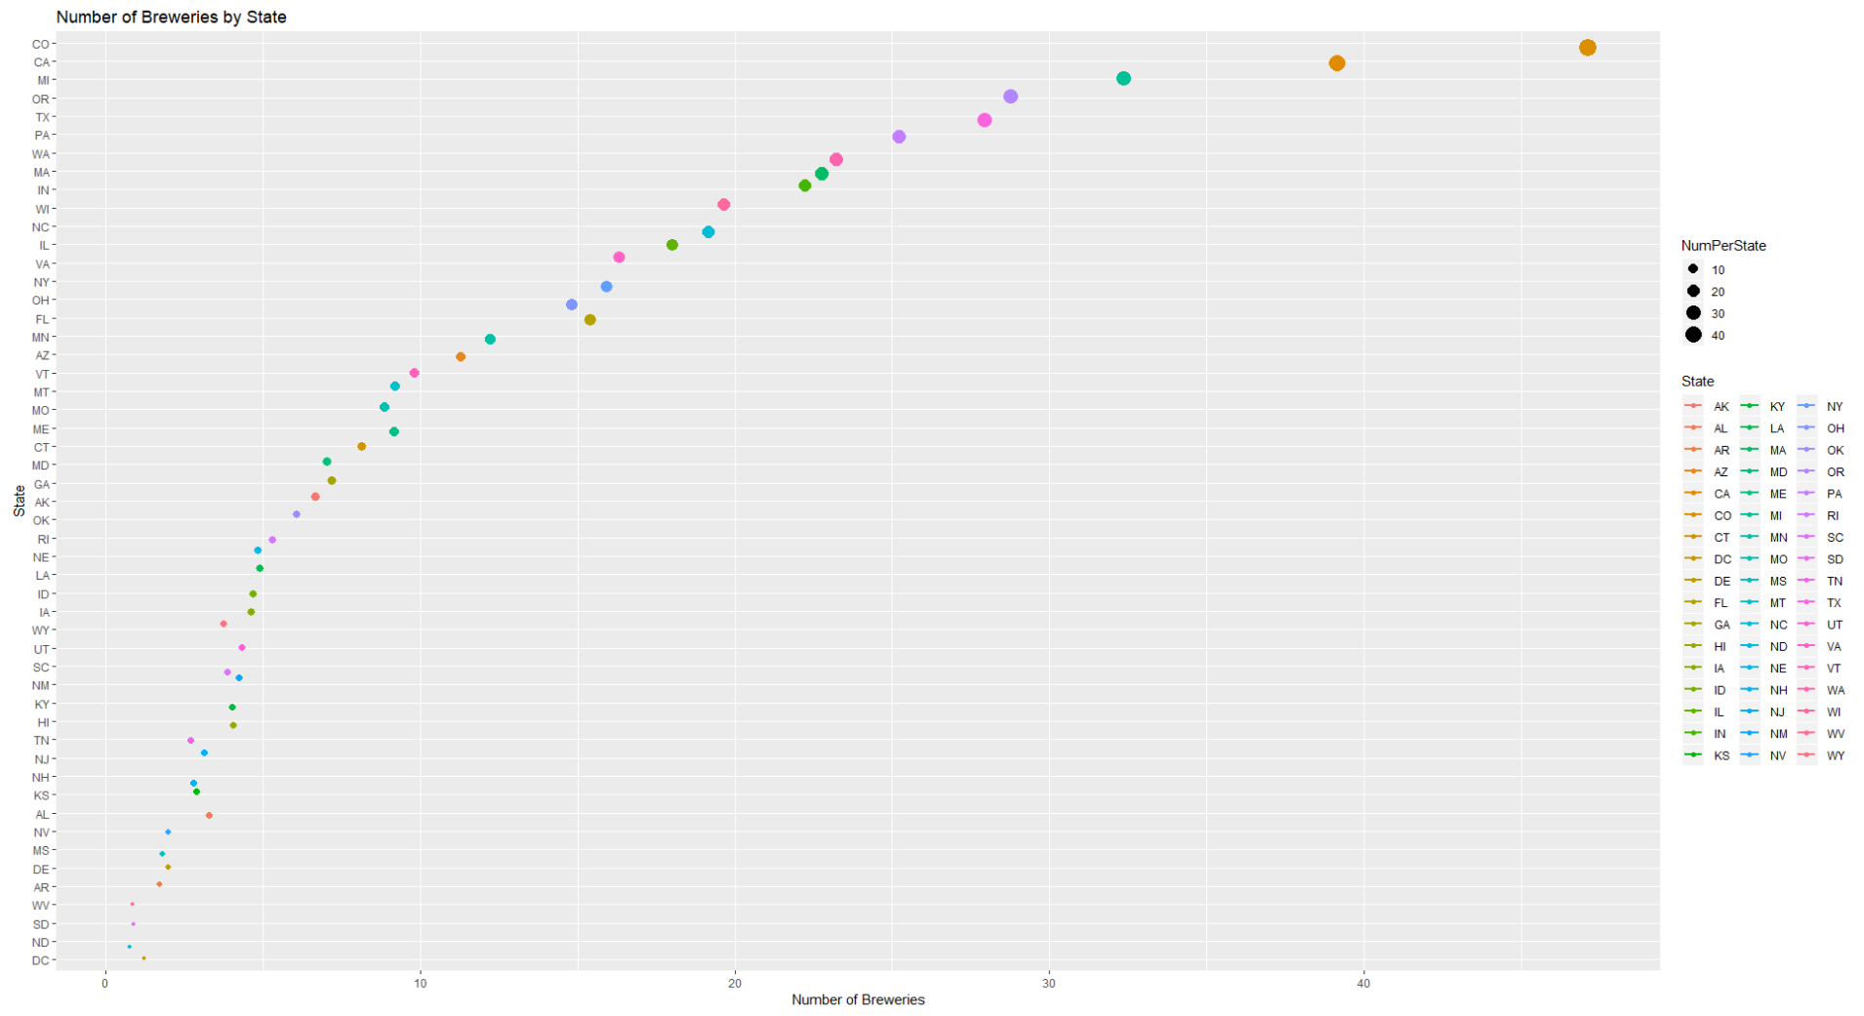

Slide 4
Top and Bottom Brewery and Beer
Top 6
Brewery Name | City | State | Beer Name | ABV | IBU | Style | Ounces
NorthGate Brewing | Minneapolis | MN | Pumpion | 0.06 | 38 | Pumpkin Ale | 16
NorthGate Brewing | Minneapolis | MN | Stronghold | 0.06 | 25 | American Porter | 16
NorthGate Brewing | Minneapolis | MN | Parapet ESB | 0.056 | 47 | Extra Special / Strong Bitter (ESB) | 16
NorthGate Brewing | Minneapolis | MN | Get Together | 0.045 | 50 | American IPA | 16
NorthGate Brewing | Minneapolis | MN | Maggie's Leap | 0.049 | 26 | Milk / Sweet Stout | 16
NorthGate Brewing | Minneapolis | MN | Wall's End | 0.048 | 19 | English Brown Ale | 16
Bottom 6
Brewery Name | City | State | Beer Name | ABV | IBU | Style | Ounces
Ukiah Brewing | Ukiah | CA | Pilsner Ukiah | 0.055 | NA | German Pilsener | 12
Butternuts Beer and Ale Garrattsville | Garrattsville | NY | Porkslap Pale Ale | 0.043 | NA | Ameracan Pale Ale (APA) | 12
Butternuts Beer and Ale Garrattsville | Garrattsville | NY | Snapperhead IPA | 0.068 | NA | American IPA | 12
Butternuts Beer and Ale Garrattsville | Garrattsville | NY | Moo Thunder Stout | 0.049 | NA | Milk / Sweet Stout | 12
Butternuts Beer and Ale Garrattsville | Garrattsville | NY | Heinnieweisse Weissebier | 0.049 | NA | Hefeweizen | 12
Sleeping Lady Brewing Company | Anchorage | AK | Urban Wilderness Pale Ale | 0.049 | NA | English Pale Ale | 12

Slide 5
Report on NA values
The following percentages represent the NA values in the data set:
ABV: 2.6%
IBU: 41.7%
*These values are null values and not “Not Applicable” values

Slide 6
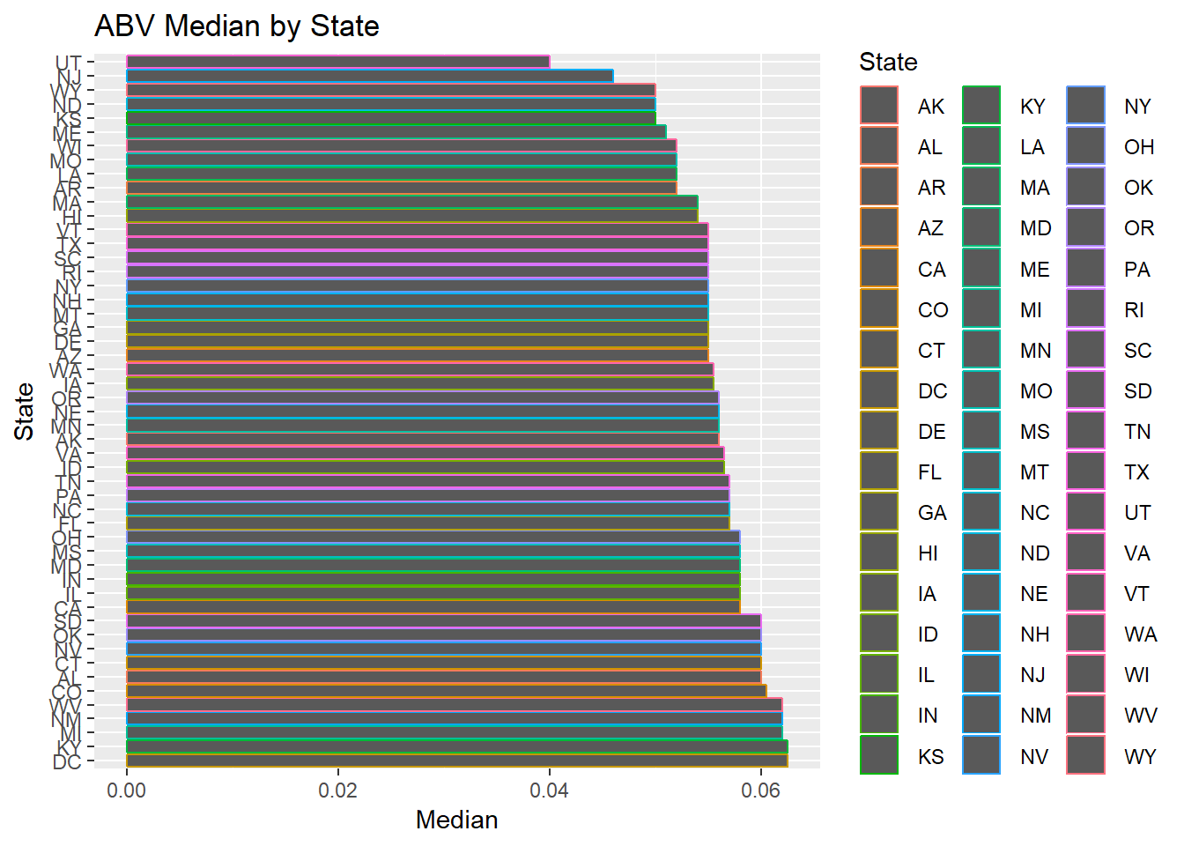
ABV Median by State
States with the highest alcoholic beer:
Kentucky and Washington DC
6.25% ABV

Slide 7
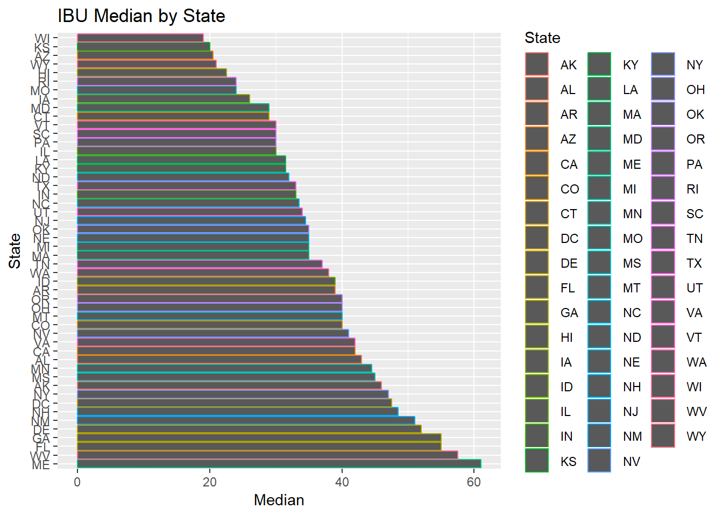
IBU Median by State
State that has the most bitter beer:
Maine
61 IBU

Slide 8
ABV and IBU summary
 | ABV | IBU
Mean | 5.98% | 42.71
Median | 6.7% | 35
Minimum | 0.01% | 4
Maximum | 12.8% | 138

Slide 9
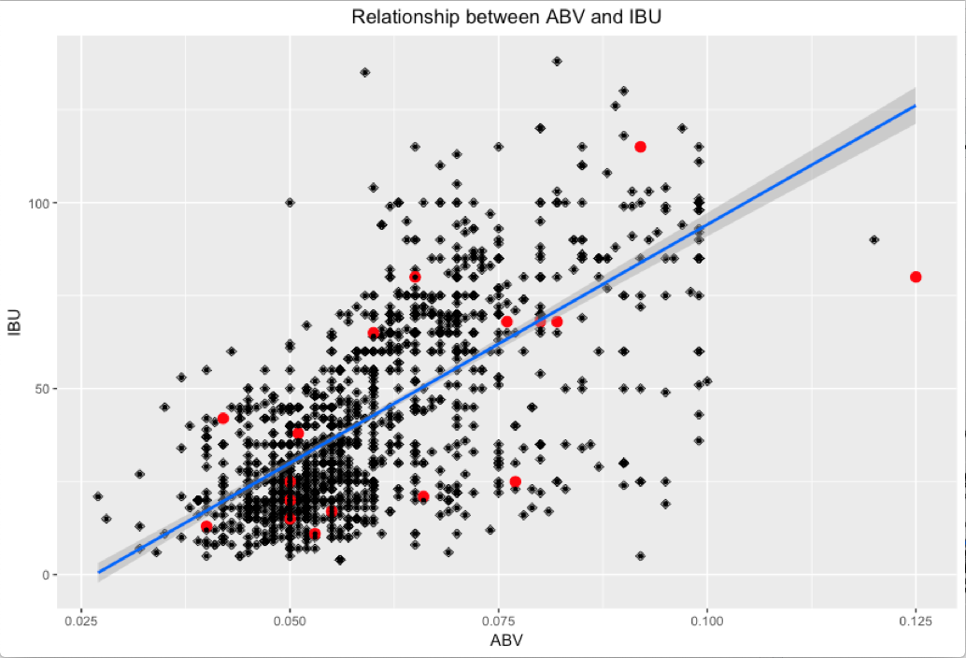
Relationship between abv and ibu

Slide 10

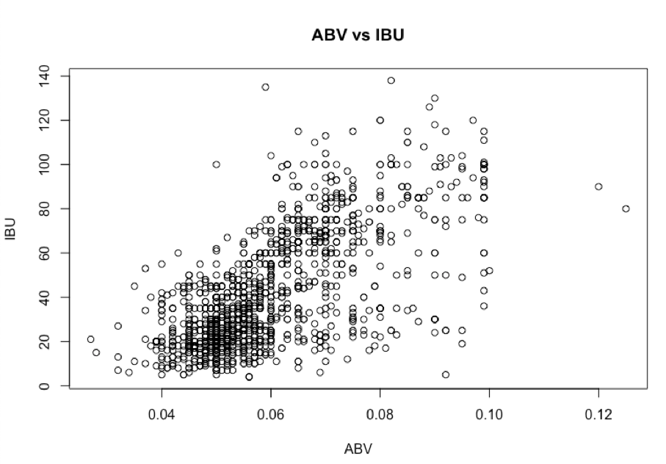
CORRELATION BETWEEN ABV AND IBU
p-value < 0.0001
Correlation coefficient = 0.67

Slide 11
Thank you
Any questions?

Slide 12
Link to BRUCE lee’s youtube video of presentation
https://youtu.be/DfqoY3E3fo8

